Slide 1

Array Basics in c++
By Varun Bansal

Slide 2

What and Why Variables

Slide 3


Let’s say we have to use a value again and again.

Slide 4
Basic Solution :
Use that value again and again wherever it is required .

Slide 5

Problems

Slide 6

Not a good idea
Not very fast
We are not using our machines efficiently
If Value is changed we need to change at all the Places.
Very Tedious

Slide 7
Solution

Slide 8

Solutions
Declare a variable and use that wherever the value is required.

Slide 9

Arrays

Slide 10

Suppose the teacher wants to store the names of 100 Students.
Should she declare 100 variables??

Slide 11
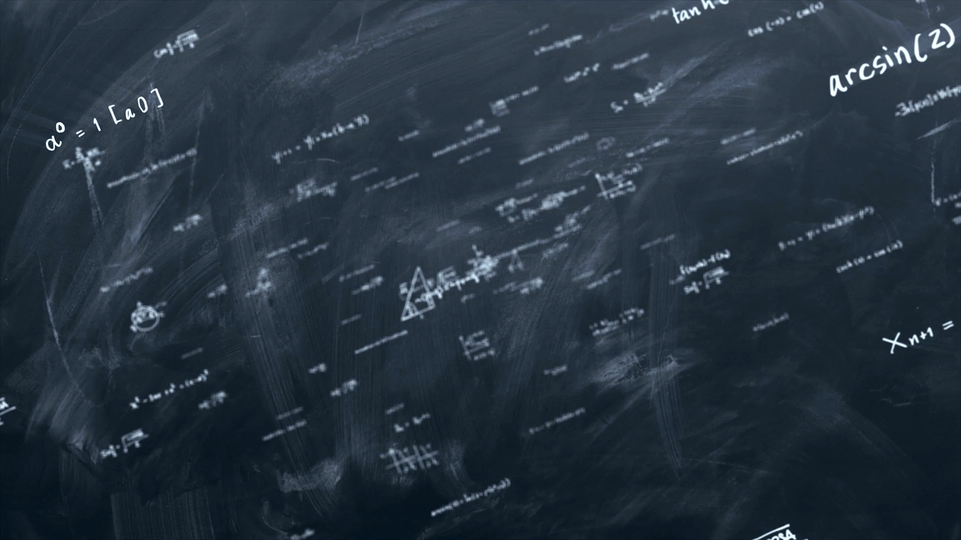
Obviously No
Too time taking
Not a practical solution
What if count is in Millions.

Slide 12
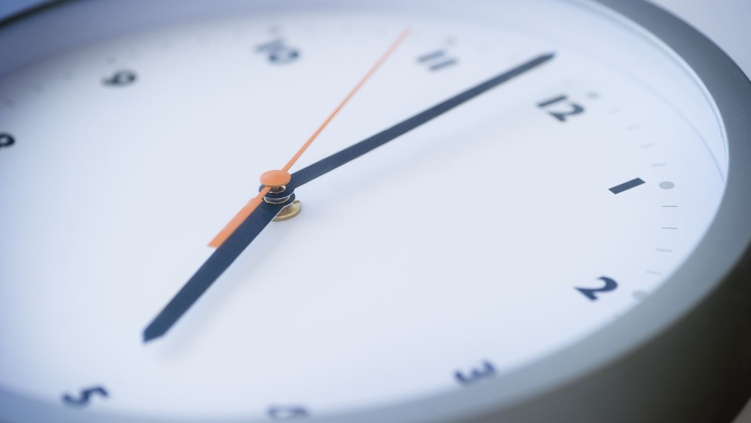
time taking

Slide 13
practical solution

